Slide 1
Lesson 4: Network topologies
Mack 2023
Notes:
Last updated 30-11-2021
Resources are updated regularly — the latest version is available at: ncce.io/tcc.
This resource is licensed under the Open Government Licence, version 3. For more information on this licence, see ncce.io/ogl.

Slide 2

Compare two network models
Starter activity
Task
Compare a peer-to-peer network with a client–server network.
Explorer task
List the network hardware components that were introduced last lesson. Can you remember them all?

Slide 3
Compare two network models
Starter activity
In a peer-to-peer network, each workstation can perform the role of the client and the server. The roles are interchangeable based on the needs of the user.
In a client–server network there is a dedicated server to fulfil the requests of the client.

Slide 4
Compare two network models
Starter activity
Explorer task
Network hardware components:
Network interface card (NIC)
Switch
Bridge
Router
Wireless access point (WAP)
Hub
Server

Slide 5

Lesson 4: Network topologies
Objectives
In this lesson, you will:
Draw and describe a star, bus, mesh, and ring topology
Describe the advantages and disadvantages of the star, bus, mesh, and ring topologies
Select an appropriate topology for a given scenario

Slide 6
Networks recap
Activity 1
At this point in the unit you should be aware of the two main models used in a computer network:
Peer-to-peer
Client–server
You should also be aware of the three types of area network:
PAN
LAN
WAN

Slide 7
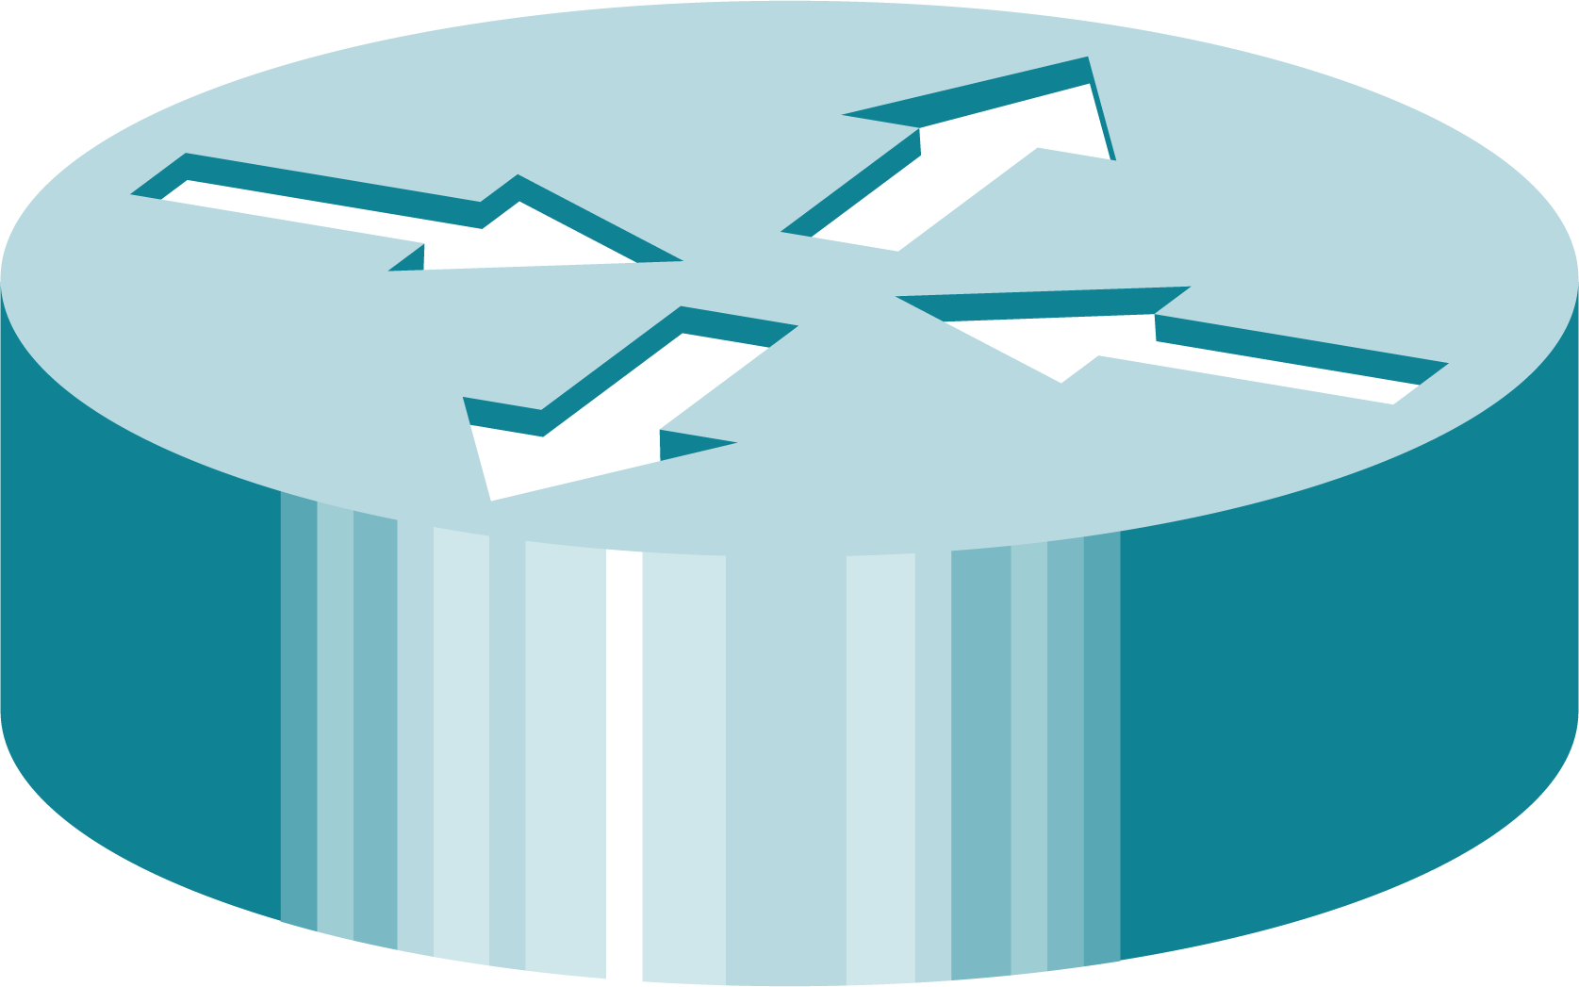
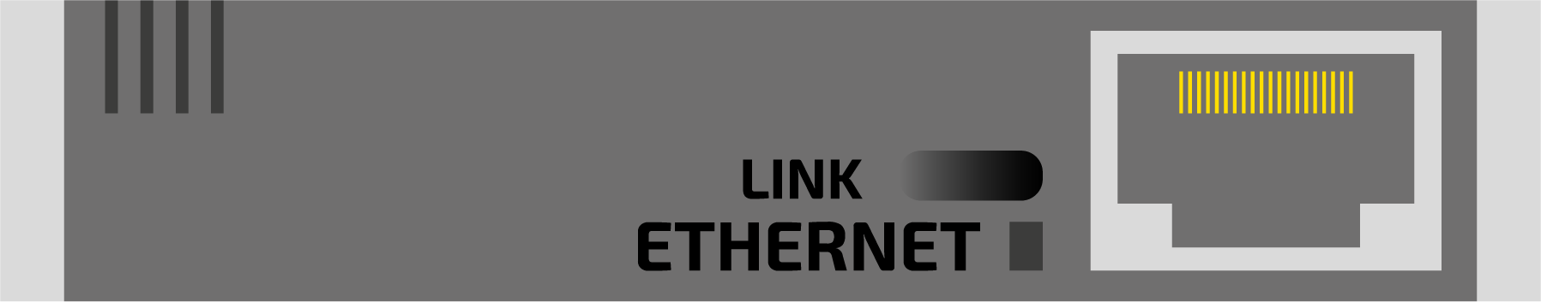
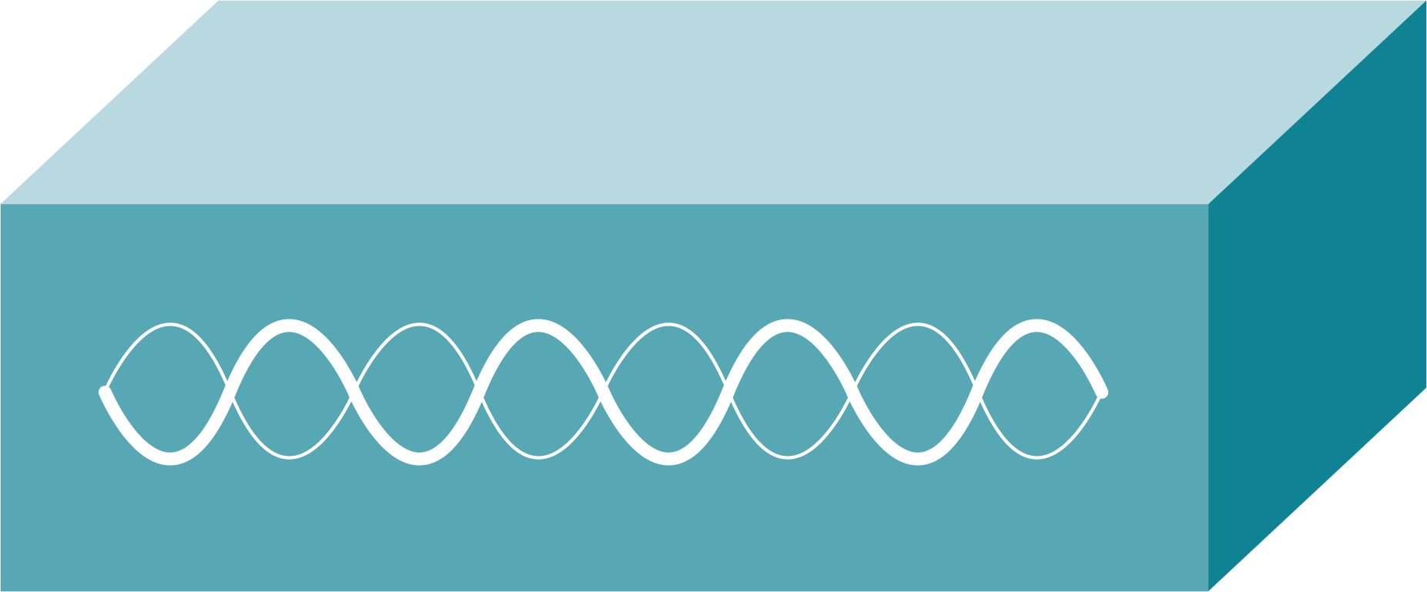




Networks recap
Activity 1
And you should know some of the common hardware components used in a network:
Network interface card (NIC)
Switch
Bridge
Router
Wireless access point (WAP)
Hub
Server

Slide 8
Network topologies
Activity 1
You are now going to look at how devices and components in a network can be arranged.
There are many different arrangements for network engineers to choose from.
These arrangements are called topologies.

Slide 9
Network topologies
Activity 1
Graphs are sometimes used to represent the different topologies (arrangements).
The nodes (dots) illustrate a component in the network and the edges (lines) represent how they are connected to each other.

Slide 10

Network topologies
Activity 1
This is a graph for a star topology.
The arrangement has one central node with all of the other nodes connected to it.
The central node would typically be a hub or a switch that could transfer data between nodes.
You might see network diagrams where the server is at the central node. These aren’t accurate. The server would be attached to the central node.

Slide 11
Network topologies
Activity 1
If a hub is in the central node then it will broadcast the data to all nodes connected to it.
Broadcast is a term used to describe the message being transmitted to all connected nodes.
✉

Slide 12
Network topologies
Activity 1
If a hub is in the central node then it will broadcast the data to all nodes connected to it.
✉
✉

Slide 13
Network topologies
Activity 1
If a hub is in the central node then it will broadcast the data to all nodes connected to it.
✉
✉
✉
✉
✉
✉

Slide 14
Network topologies
Activity 1
If a hub is in the central node then it will broadcast the data to all nodes connected to it.
The red crosses indicate that the message has been ignored because it wasn’t addressed to that location.
✉
✉
╳
╳
✉
✉
✔
✉
✉
╳

Slide 15
Network topologies
Activity 1
If a switch is in the central node then it will transfer the data to the required location.
✉

Slide 16
Network topologies
Activity 1
If a switch is in the central node then it will transfer the data to the required location.
✉
✉

Slide 17
Network topologies
Activity 1
If a switch is in the central node then it will transfer the data to the required location.
✉
✉
✔
✉

Slide 18
Network topologies
Activity 1
This is a graph for a bus topology.
In this arrangement, each node is connected to a single cable. When data is sent from one node to another it is sent in both directions.
Terminators are placed at the end of the cable to stop the signal being reflected back down the cable.

Slide 19
Network topologies
Activity 1
In a bus topology the data is sent to all nodes connected to the bus. It is only accepted by the node that requires it.
✉

Slide 20
Network topologies
Activity 1
In a bus topology the data is sent to all nodes connected to the bus. It is only accepted by the node that requires it.
✉
✉

Slide 21
Network topologies
Activity 1
In a bus topology the data is sent to all nodes connected to the bus. It is only accepted by the node that requires it.
✉
✉
✉
✉
✉

Slide 22
Network topologies
Activity 1
In a bus topology the data is sent to all nodes connected to the bus. It is only accepted by the node that requires it.
✉
✉
✉
╳
╳
✉
✉
✔
╳

Slide 23
Network topologies
Activity 1
This is a graph for a ring topology.
In this arrangement, each node is connected in a ring. When data is transferred it moves around the ring in one direction.

Slide 24
Network topologies
Activity 1
✉
The data will continue to move around the ring until it reaches its destination.

Slide 25
Network topologies
Activity 1
✉
The data will continue to move around the ring until it reaches its destination.
✉

Slide 26
Network topologies
Activity 1
✉
The data will continue to move around the ring until it reaches its destination.
✉
╳

Slide 27
Network topologies
Activity 1
✉
The data will continue to move around the ring until it reaches its destination.
✉
╳
✉

Slide 28
Network topologies
Activity 1
✉
The data will continue to move around the ring until it reaches its destination.
✉
╳
✉
╳

Slide 29
Network topologies
Activity 1
✉
The data will continue to move around the ring until it reaches its destination.
✉
╳
✉
╳
✉

Slide 30
Network topologies
Activity 1
✉
The data will continue to move around the ring until it reaches its destination.
✉
╳
✉
╳
✉
✔

Slide 31
Network topologies
Activity 1
This is a graph for a mesh topology.
In this arrangement, there are multiple ways for data to transfer from one node to another.
In a mesh network, each node is connected to at least one other node. It is more common for them to be connected to more than one node.

Slide 32
Network topologies
Activity 1
✉
In a mesh network the most efficient route is typically calculated before transferring the required data.

Slide 33
Network topologies
Activity 1
✉
In a mesh network the most efficient route is typically calculated before transferring the required data.

Slide 34
Network topologies
Activity 1
✉
In a mesh network the most efficient route is typically calculated before transferring the required data.
✉

Slide 35
Network topologies
Activity 1
✉
In a mesh network the most efficient route is typically calculated before transferring the required data. This can help to reduce transmission time.
✉
✔

Slide 36
Can you remember the names of all four topologies?
Activity 1
A
B
C
D

Slide 37
Can you remember the names of all four topologies?
Activity 1
A
B
C
D
Star
Bus
Ring
Mesh

Slide 38
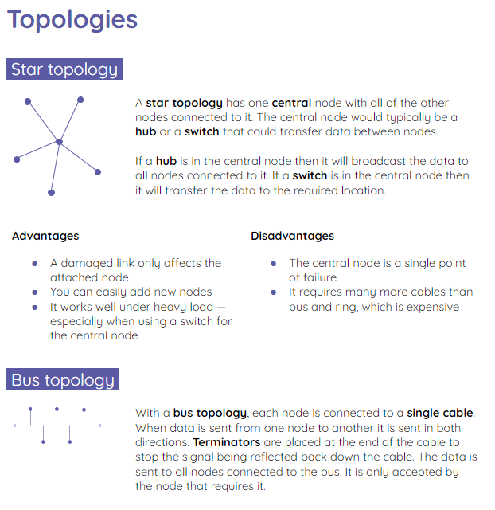
Exploring the advantages and disadvantages
Activity 2
Complete the activity 2 sheet where you will explore the advantages and disadvantages of each topology.
You will then use the advantages and disadvantages to help you determine the most suitable topology for the scenarios given.

Slide 39
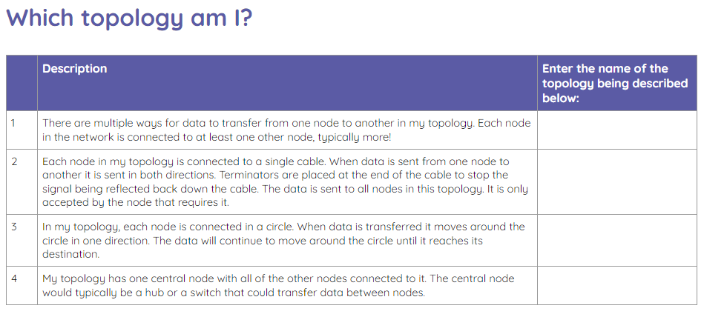
Which topology am I?
Wrap Up
Complete the activity sheet to spot which topology is being described.

Slide 40
Which topology am I?
Warp Up
Mesh
Bus
Ring
Star

Slide 41
Next lesson
Summary
In this lesson, you…
Learnt about the star, bus, ring, and mesh topologies
Next lesson, you will…
Delve into wired and wireless data transmission

